Slide 1
First Star Academy
Brianna Harris

Slide 2
Business Description
FIRST STAR FOSTER YOUTH ACADEMY
Foster Care and Education
Founded In 1999
Global Academy
  The First Star Academy at St Mary’s University is the first in the UK.
  Several Chapter in the US
University Utah and First Star
  College Readiness
  Life Skills
  Academic Skills

Slide 3
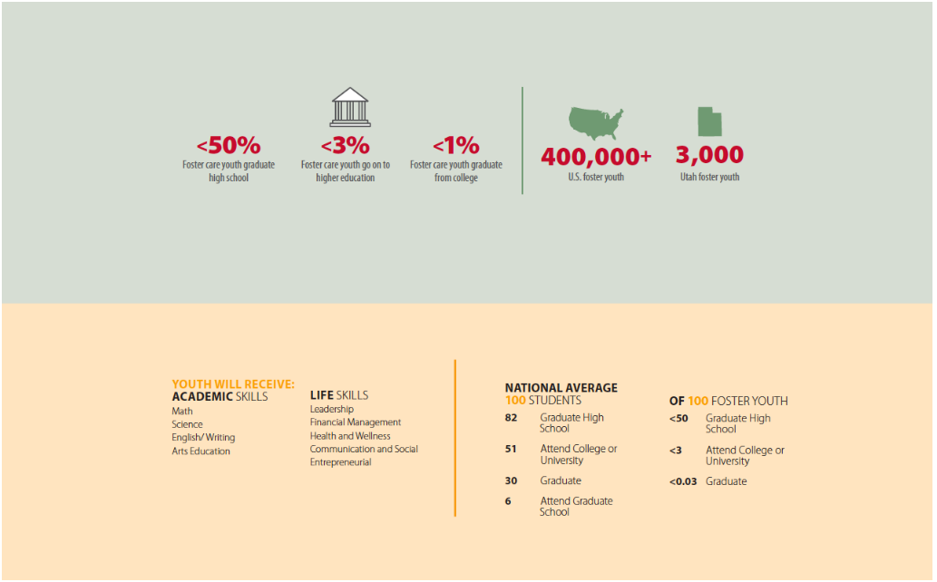
Business Description

Slide 4
Entity Types
PERSON | ACADEMY | GRADUATION | WORK | NOTES
FACULTY | CLASS | CAREGIVER | STUDENT | VIDEO
STORY

Slide 5
Data Requirements
Person | Person_ID, First_Name, Middle_Name, Last_Name, Sex, Street, City, State, Zip, Country
Faculty | Person_ID, F_UNID
Class | course_ID, Semester, Course, Year
Caregiver | Person_ID, Type
Student | Person_ID, S_UNID, Age
Academy | Acad_ID, Name, City, Acad_year, Classification, Country, Cost
Graduation | Graduation_Year, GPA
Work | Topic, Date_Created
Notes | Topic, Related Field
Video | Topic Date_posted, Duration
Story | Topic

Slide 6
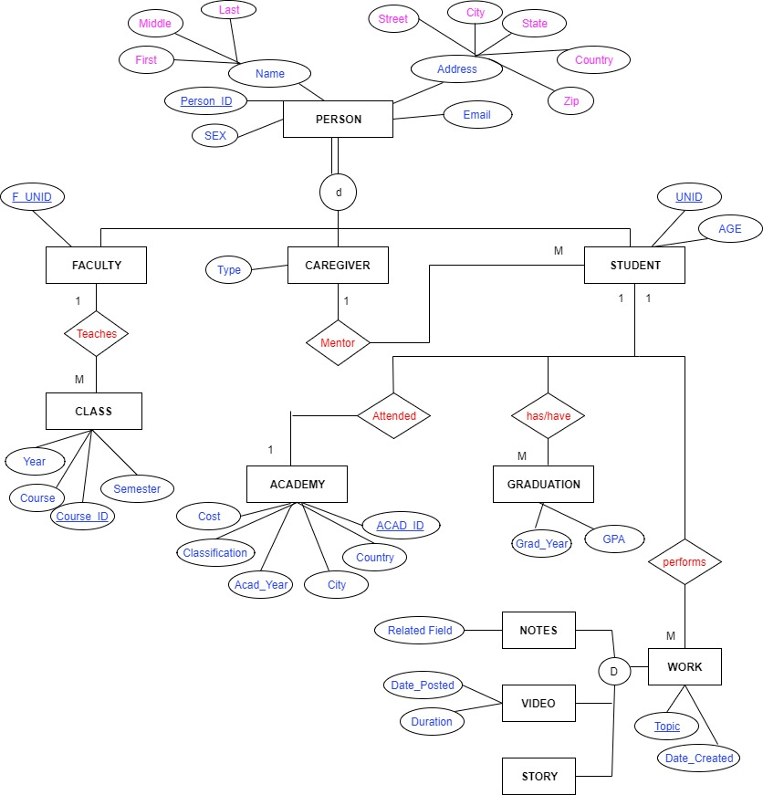
ERD
RELATIONSHIPS
Each participant in the program is tracked by a unique person ID.
  Persons are divide into subtypes of Student. Faculty and caregiver
Each Student is assigned a caregiver for the program.
  That care giver type may be biological or non-biological
Students may take one or many course taught by a faculty member
  Faculty will teach many courses and many students
Students will participate in a series of work activates which include Notes, videos and stories
Students GPA will be tracked during the program. Especially at graduation

Slide 7
Relational Model
Person | ( Person_ID, First_Name, Middle_Name, Last_Name, Sex, Street, City, State, Zip, Country)
Faculty | (Person_ID, F_UNID) FK(Person_ID) ref Person(Person_ID)
Class | ( Course_ID, Semester, Course, Year, F_UNID) FK (Faculty_ID) ref Faculty (Faculty_ID)
Caregiver | ( Person_ID, Type) FK(Person_ID) ref Person(Person_ID)
Student | (Person_ID, UNID, Age, ACAD_ID) FK(Person_ID) ref Person(Person_ID) FK(ACAD_ID) ref Academy(ACAD_ID)
Academy | (Acad_ID, Name, City, Acad_Year, Classification, Country, Cost )
Graduation | ( Graduation_Year, GPA,S_UNID) FK(S_UNID) ref Student (S_UNID)

Slide 8
Relational Model
Work | (Topic, Date_Created,S_UNID) FK(S_UNID) ref Student (S_UNID)
Notes | (Topic, Related Field) Fk (topic) ref Work (Topic)
Video | (Topic Date_posted, Duration) Fk (topic) ref Work (Topic)
Story | (Topic) Fk (topic) ref Work (Topic)

Slide 9
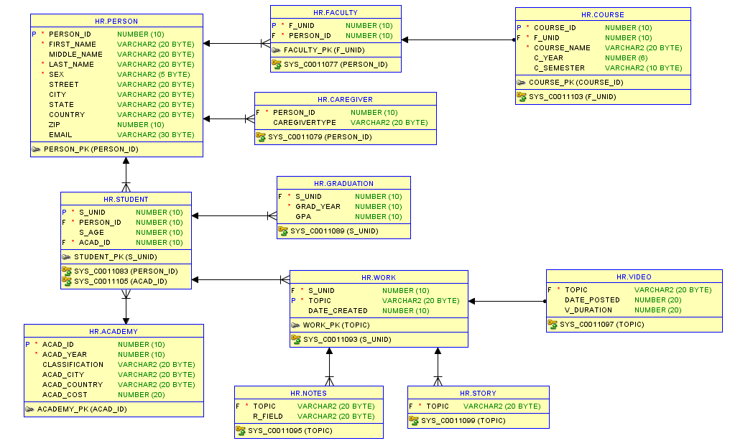
Physical Data Model

Slide 10
Queries
Query 1: Business Function
List details of Students, city and Academy from where they belong, who are part of Foster care program?
As annual report needs to be generated as per government standards, for assessment and funding purposes, it’s important to have exact number of student’s part of Foster Program from different Academy all over the world.
SQL 1:
select First_Name,Middle_Name,Last_Name,SEX,Street,City,State,Country,Zip,EMAIL,CLASSIFICATION,ACAD_CITY,ACAD_COUNTRY
from PERSON
INNER JOIN STUDENT
ON PERSON.PERSON_ID = STUDENT.PERSON_ID
INNER JOIN ACADEMY
ON STUDENT.ACAD_ID=ACADEMY.ACAD_ID;

Slide 11
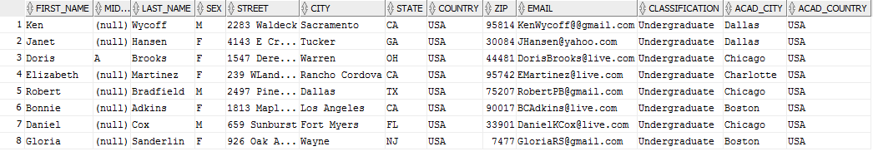
DEMO 1 Result:

Slide 12
Queries
Query 2: Business Function
What is the average age of students who attend First Star are part of Foster Program?
Students who are a part of foster program are of varied age groups. Average age can give an idea participating in Foster Program.
SQL 2:
select round(avg(S_AGE)) as AverageAge
from STUDENT;

Slide 13

DEMO 2 Result:

Slide 14
Queries
Query3: Business Function
How many students from Chicago Academy are part of Foster Program?
As students who are part of First Star can be from any Academy from the World, sometimes for descriptive report, Specific Academy needs to be addressed.
SQL 3:
CREATE VIEW stu_student AS
SELECT STUDENT.S_UNID, ACADEMY.ACAD_CITY
FROM STUDENT
INNER JOIN ACADEMY
ON STUDENT.ACAD_ID = ACADEMY.ACAD_ID
WHERE ACADEMY.ACAD_CITY = 'Chicago';
Select * from STU_STUDENT;

Slide 15
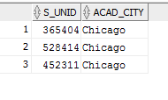
DEMO 3 Result:

Slide 16
Queries
Query4: Business Function
How many students of Foster Care do not have Biological Family?
At First Star , they try to track how many students have reunited with their biological parents and how many do not have one.
SQL 4:
select count(CAREGIVERTYPE) as NFStudents from CAREGIVER where CAREGIVERTYPE='Non-Biological';

Slide 17

DEMO 4 Result:

Slide 18
Queries
Query5: Business Function
List field of work Students perform at First Star academy?
Students work is important for any university they are studying at. They are one of the most useful resource to represent productivity of students.
SQL 5:
select First_Name,Last_Name,Topic,DATE_CREATED
from PERSON
INNER JOIN STUDENT
ON PERSON.PERSON_ID = STUDENT.PERSON_ID
INNER JOIN WORK
ON STUDENT.S_UNID=WORK.S_UNID;

Slide 19
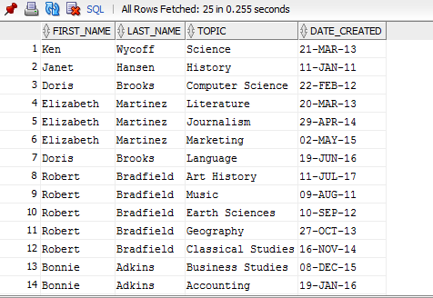
DEMO 5 Result:

Slide 20
Dynamic Views
/* P_PERSON*/
CREATE VIEW P_PERSON AS
SELECT First_Name, Last_Name, Sex
FROM PERSON P, STUDENT S
where P.PERSON_ID = S.PERSON_ID;
/* P_CARE*/
CREATE VIEW P_CARE AS
SELECT First_Name, Last_Name, Sex
FROM PERSON P, CAREGIVER C
where P.PERSON_ID = C.PERSON_ID;
/*P_FAC */
CREATE VIEW P_FAC AS
SELECT First_Name, Last_Name, Sex
FROM PERSON P, FACULTY F
where P.PERSON_ID = F.PERSON_ID;

Slide 21
Thank You

